Slide 1
Cryptosystem Classification
By type of encryption operations used
Substitution
Transposition
By number of keys used
Single-key or private
Two-key or public
By the way in which plaintext is processed
Block
Stream
1
1

Slide 2
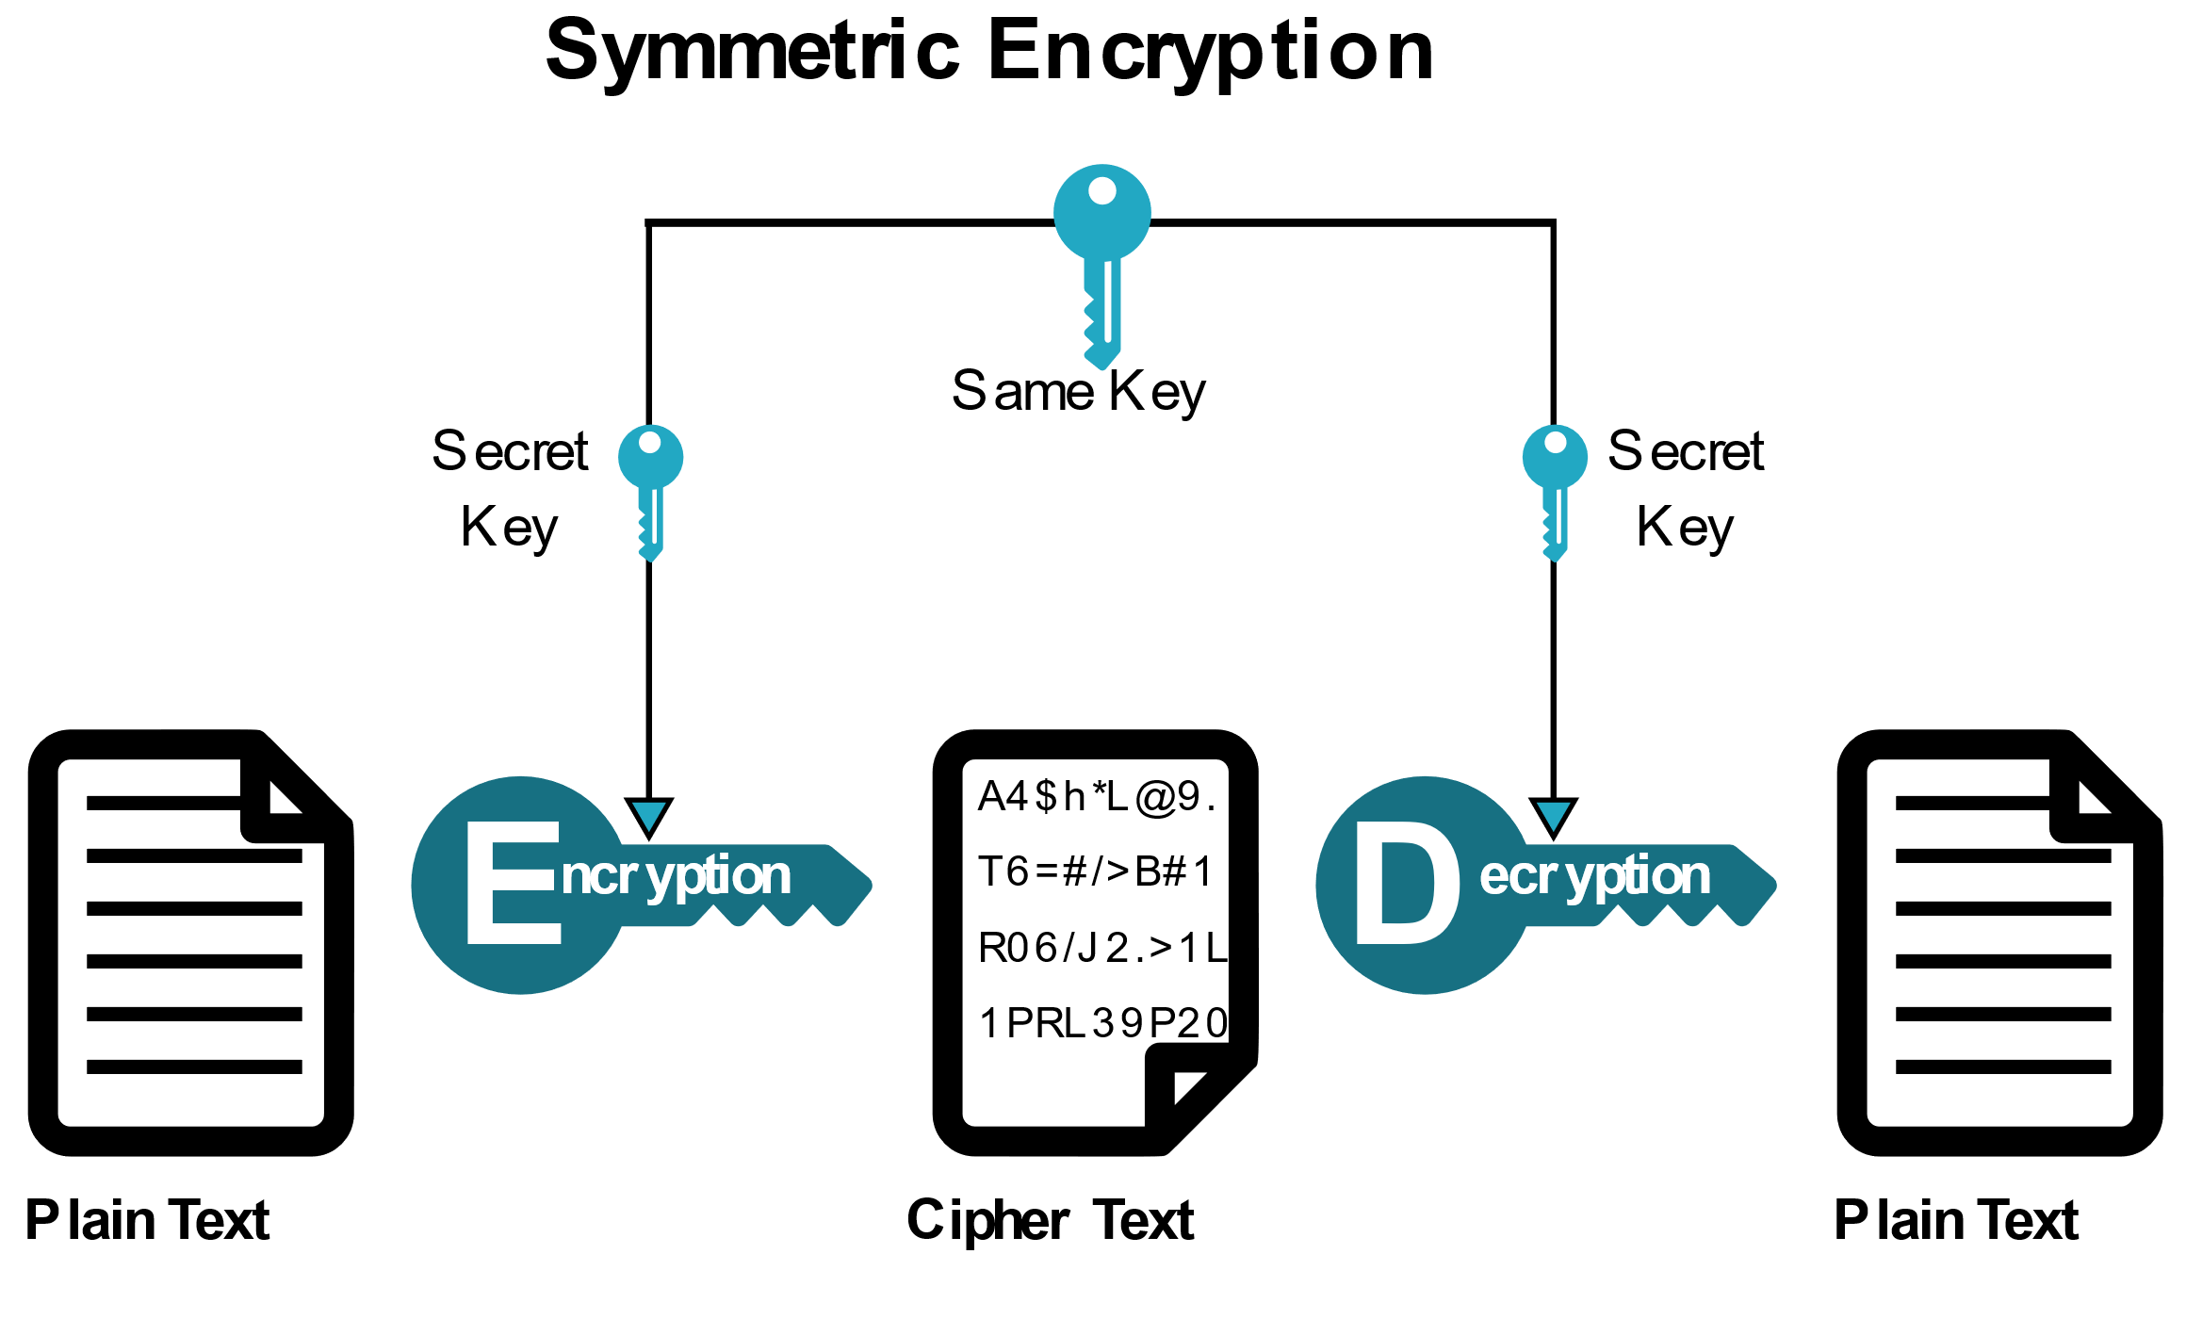
Cryptosystem Classification
By number of keys used
Single-key or private
Two-key or public
1
1

Slide 3
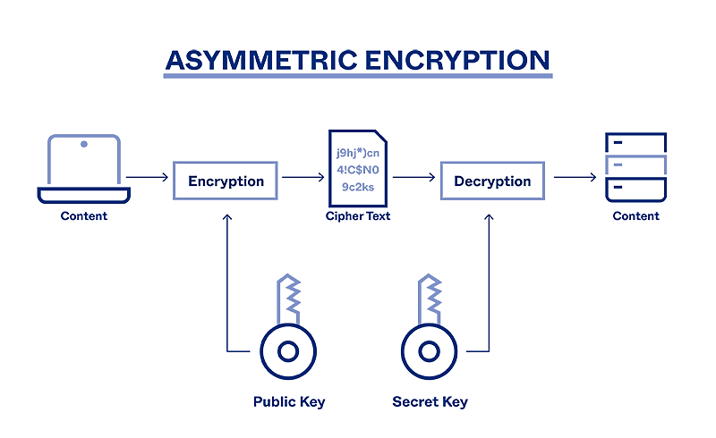
Cryptosystem Classification
By number of keys used
Single-key or private
Two-key or (private + public)
1
1

Slide 4
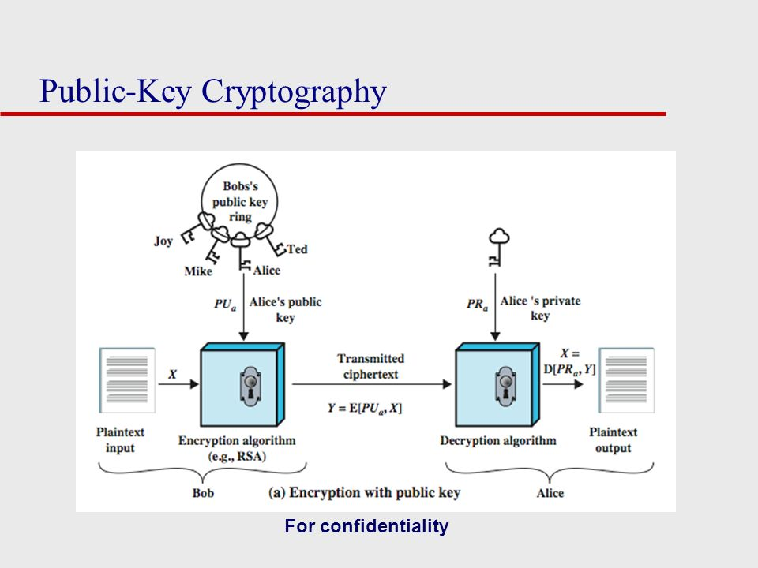
Cryptosystem Classification
Two-key or (private + public)
public key is used to encrypt
Private key is used to decrypt
1
1

Slide 5
Cryptosystem Classification
By type of encryption operations used
Substitution
Transposition
By number of keys used
Single-key or private
Two-key or public
By the way in which plaintext is processed
Block
Stream
1
1

Slide 6
Stream cipher
A stream cipher is one that encrypts a digital data stream one bit or one byte at a time.
Block cipher
A block cipher is one in which a block of plaintext is treated as a whole and used to produce a ciphertext block of equal length.
Block Cipher and Stream Cipher belongs to the symmetric key cipher.

Slide 7
Stream cipher
A stream cipher is one that encrypts a digital data stream one bit or one byte at a time.
C=P⊕K P=C⊕K

Slide 8
Block cipher
A block cipher is one in which a block of plaintext is treated as a whole and used to produce a ciphertext block of equal length.
.

Slide 9
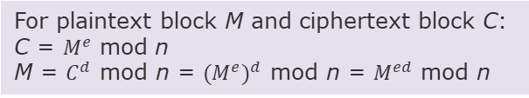
Public-Key Cryptanalysis
9.2. The RSA Algorithm
The scheme developed by Rivest, Shamir, and Adleman makes use of an expression with exponentials.
Plaintext is encrypted in blocks, with each block having a binary value less than some number n. That is, the block size must be less than or equal to log2(n).
Hash function
For plaintext block M and ciphertext block C:
C = $M^{e}$ mod n
M = $C^{d}$ mod n = ${(M^{e})}^{d}$ mod n = $M^{ed}$ mod n
Thus, this is a public-key encryption algorithm with a public key of PU = {e, n} and a private key of PR = {d, n}.
9 / 26

Slide 10
What Hash function?
Network Security
A H M
Sarowar Sattar
Hash function
Cryptographic Hash Functions
A hash function maps a variable-length message into a fixed-length hash value, or message digest.
Applications of Crypto Hash Functions
The values returned by a hash function are called hash values, hash codes, hash sums, message digest or simply hashes.
MD5 Message Digest Algorithm
Property of a good Hash function
Secure Hash Algorithm (SHA)
The results of applying the function to a large set of inputs will produce outputs that are evenly distributed and apparently random.
Summary
Acknowledgement
10 / 26

Slide 11
A cryptographic hash function
Network Security
A H M
Sarowar Sattar
Cryptographic Hash Functions
A cryptographic hash function is an algorithm for which it is
computationally infeasible to find either
a data object that maps to a pre-specified hash result (the one-way property) or
two data objects that map to the same hash result (the collision-free property)
Applications of Crypto Hash Functions
MD5 Message Digest Algorithm
Secure Hash
Algorithm
(SHA)
Summary
Acknowledgement
11 / 26

Slide 12
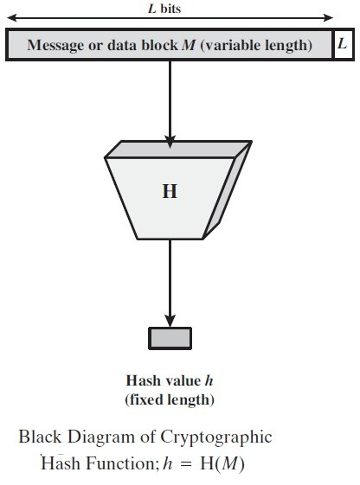
A cryptographic hash function
Network Security
A H M
Sarowar Sattar
Cryptographic Hash Functions
Applications of Crypto Hash Functions
MD5 Message Digest Algorithm
Secure Hash
Algorithm
(SHA)
Summary
Acknowledgement
12 / 26

Slide 13
Applications of Crypto Hash Functions
Network Security
A H M
Sarowar Sattar
Applications of Crypto Hash functions, Message Authentication
Digital Signature
One-way password file Intrusion detection Virus-detection
Cryptographic Hash Functions
Applications of Crypto Hash Functions
MD5 Message Digest Algorithm
Secure Hash Algorithm (SHA)
Summary
Acknowledgement
6 / 26

Slide 14
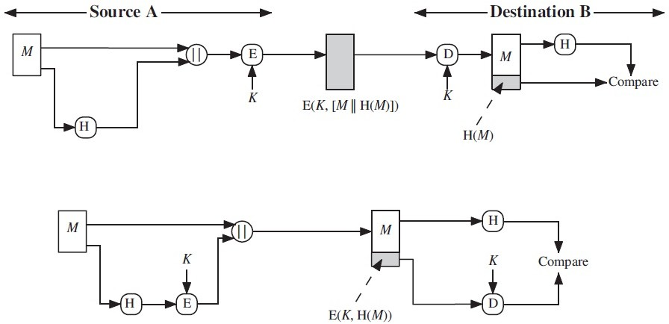
Applications of Crypto Hash Functions
Network Security
Message Authentication,
A H M
Sarowar Sattar
Cryptographic Hash Functions
Applications of Crypto Hash Functions
MD5 Message Digest Algorithm
Secure Hash Algorithm (SHA)
Summary Acknowledgement
7 / 26

Slide 15
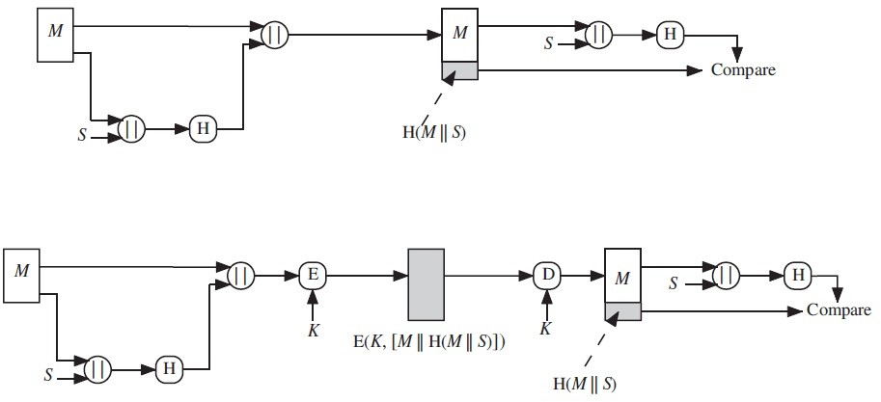
Applications of Crypto Hash Functions
Network Security
Message Authentication,
A H M
Sarowar Sattar
Cryptographic Hash Functions
Applications of Crypto Hash Functions
MD5 Message Digest Algorithm
Secure Hash Algorithm (SHA)
Summary Acknowledgement
8 / 26

Slide 16
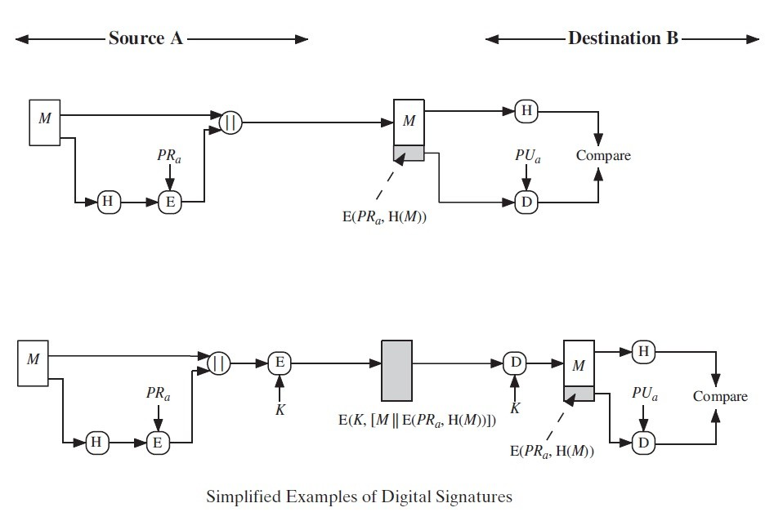
Applications of Crypto Hash Functions
Network Security
Digital Signature,
A H M
Sarowar Sattar
Cryptographic Hash Functions
Applications of Crypto Hash Functions
MD5 Message Digest Algorithm
Secure Hash Algorithm (SHA)
Summary Acknowledgement
9 / 26

Slide 17
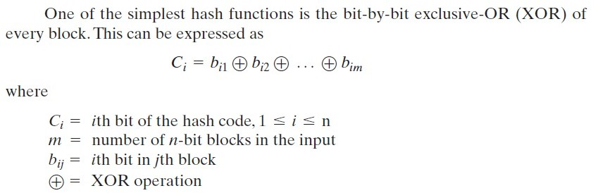
One simplified hash function
Network Security
A H M
Sarowar Sattar
Cryptographic Hash Functions
Applications of Crypto Hash Functions
MD5 Message Digest Algorithm
Secure Hash Algorithm (SHA)
Summary Acknowledgement
10 / 26

Slide 18
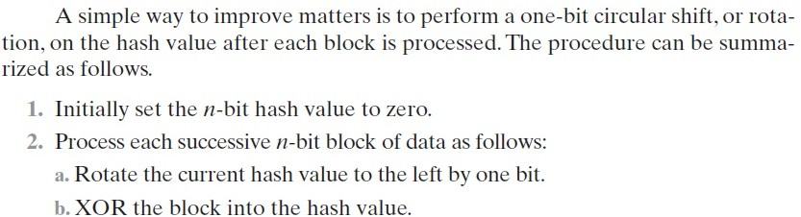
Another simplified hash function
Network Security
A H M
Sarowar Sattar
Cryptographic Hash Functions
Applications of Crypto Hash Functions
MD5 Message Digest Algorithm
Secure Hash Algorithm (SHA)
Summary Acknowledgement
11 / 26

Slide 19
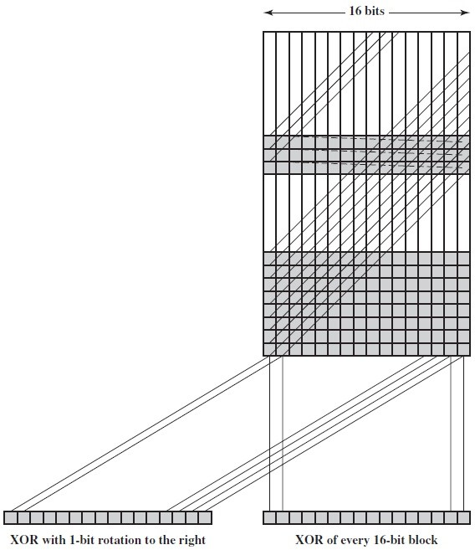
Two simplified hash functions
Network Security
A H M
Sarowar Sattar
Cryptographic Hash Functions
Applications of Crypto Hash Functions
MD5 Message Digest Algorithm
Secure Hash Algorithm (SHA)
Summary Acknowledgement
12 / 26

Slide 20
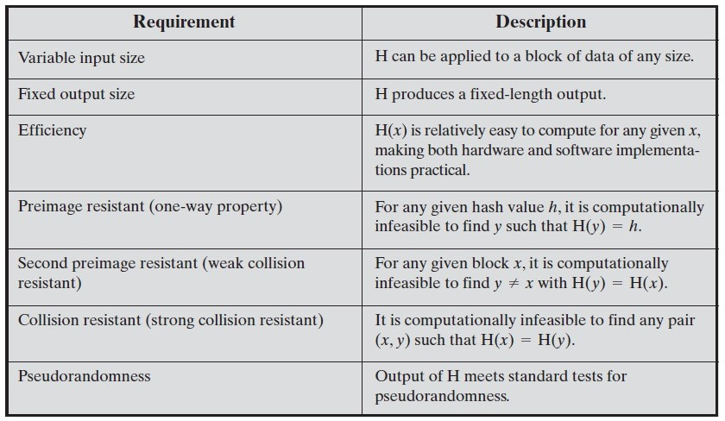
Requirements for Hash function
Network Security
A H M
Sarowar Sattar
Cryptographic Hash Functions
Applications of Crypto Hash Functions
MD5 Message Digest Algorithm
Secure Hash Algorithm (SHA)
Summary Acknowledgement
13 / 26

Slide 21
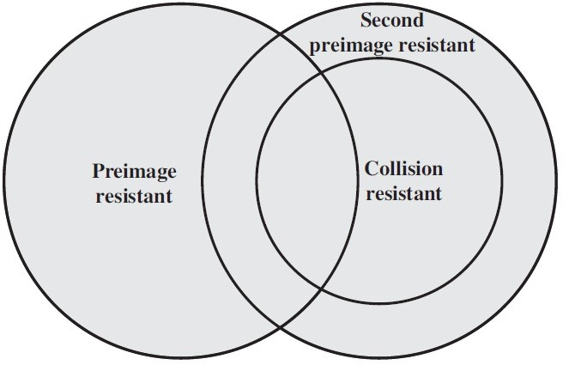
Requirements for Hash function
Network Security
Relationship Among Hash Function Properties :
A H M
Sarowar Sattar
Cryptographic Hash Functions
Applications of Crypto Hash Functions
MD5 Message Digest Algorithm
Secure Hash Algorithm (SHA)
Summary Acknowledgement
14 / 26

Slide 22
Summary
Network Security
Hash functions are used to get a digest of a message
Must take variable size input, produce fixed size pseudorandom output, be efficient to compute
Cryptographic hash functions should be preimage resistant, 2nd preimage resistant, and collision resistant
Cryptographic hashes are used for message authentication, digital signatures, password storage
A H M
Sarowar Sattar
Cryptographic Hash Functions
Applications of Crypto Hash Functions
MD5 Message Digest Algorithm
Secure Hash Algorithm (SHA)
Summary
Acknowledgement

Slide 23
Acknowledgement
Network Security
A H M
Sarowar Sattar
Lawrie Browns slides supplied with William Stallings book Cryptography and Network Security: Principles and Practice, 5th Ed, 2011
Network Security course at Department of Computer Science & Engineering, Washington University in Saint Louis.
Network Security course at Department of Computer Science, Columbia University, New York.
Cryptographic Hash Functions
Applications of Crypto Hash Functions
MD5 Message Digest Algorithm
Secure Hash Algorithm (SHA)
Summary
Acknowledgement

